Slide 1
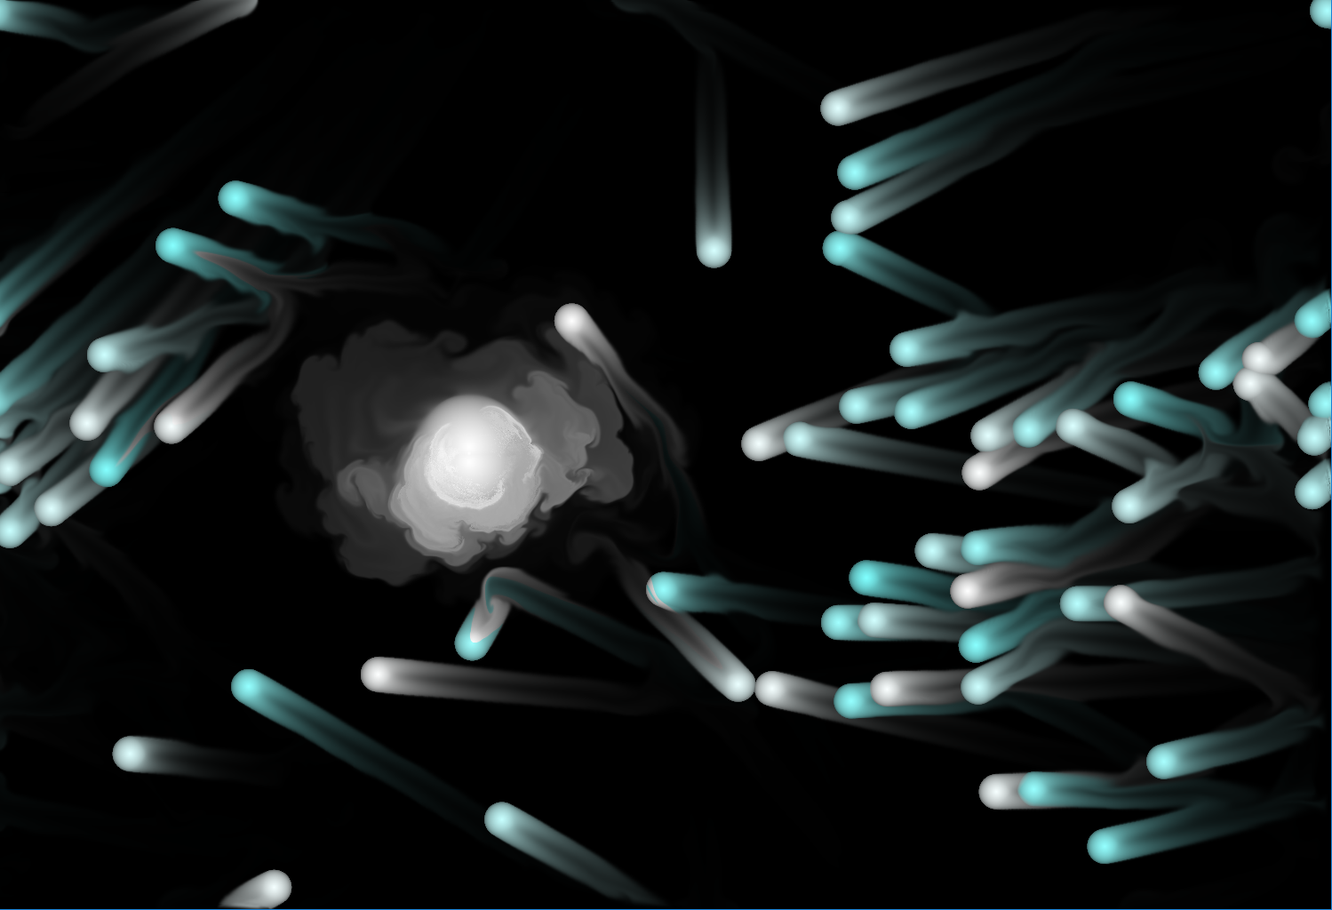
ICE BLUE
GHOST
CREATED BY ZHANG ZHENYANG. SJTU SHANGHAI.

Slide 2

Contents
01
RULES OF THE GAME
02
HIGHLIGHTS OF THE GAME
03
EFFECTS OF THE GAME

Slide 3
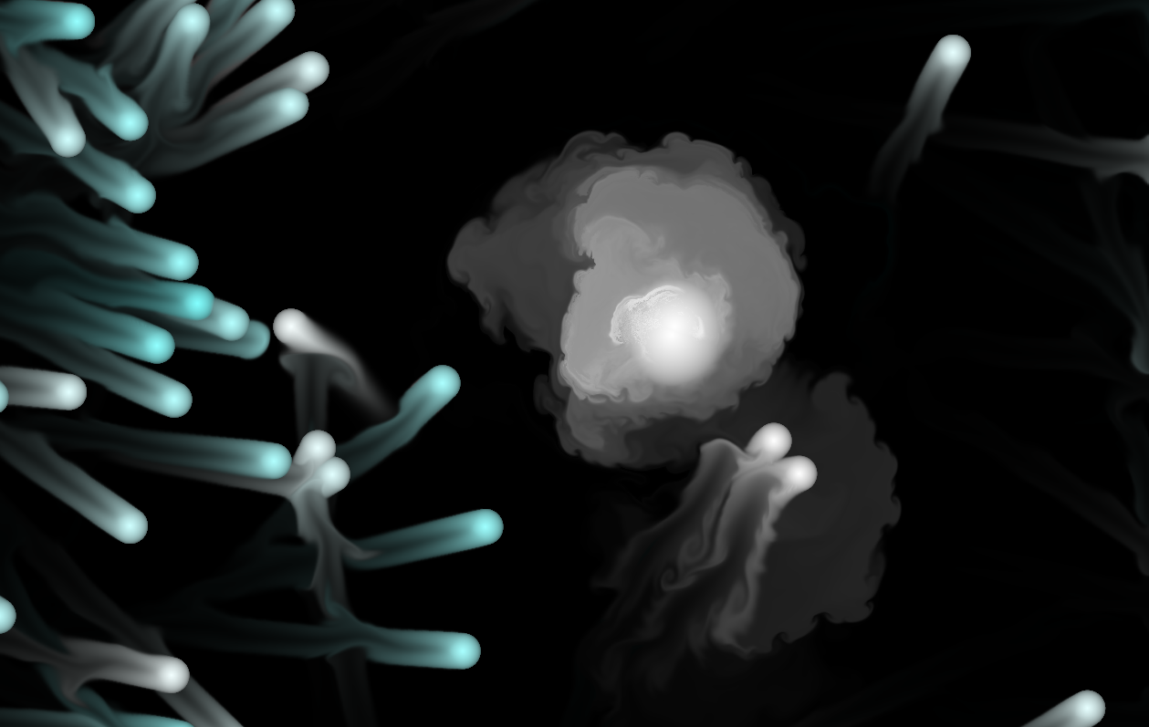
01
RULES
OF
THE
GAME

Slide 4
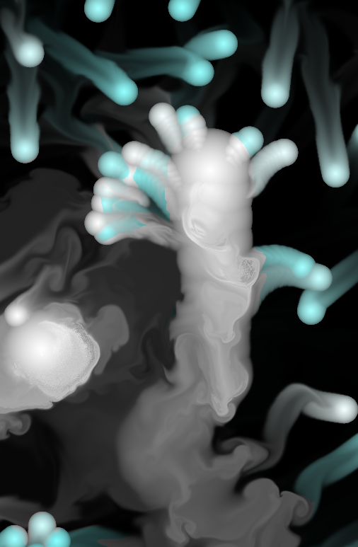
STEP
1
Use the rocker to control your white
ball to pursue other small balls

Slide 5
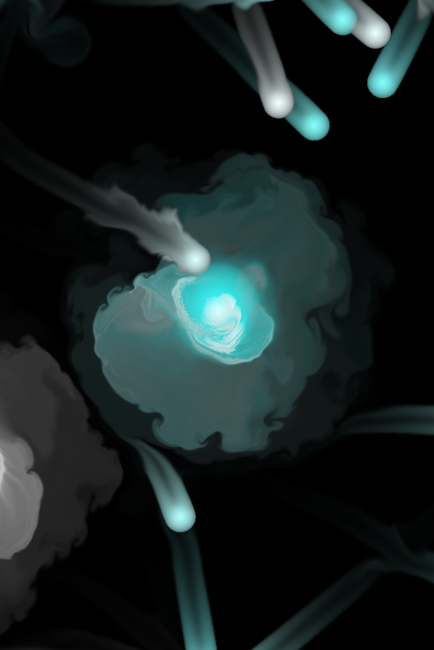
STEP
2
Try your best to get these small balls close to the central ghost

Slide 6
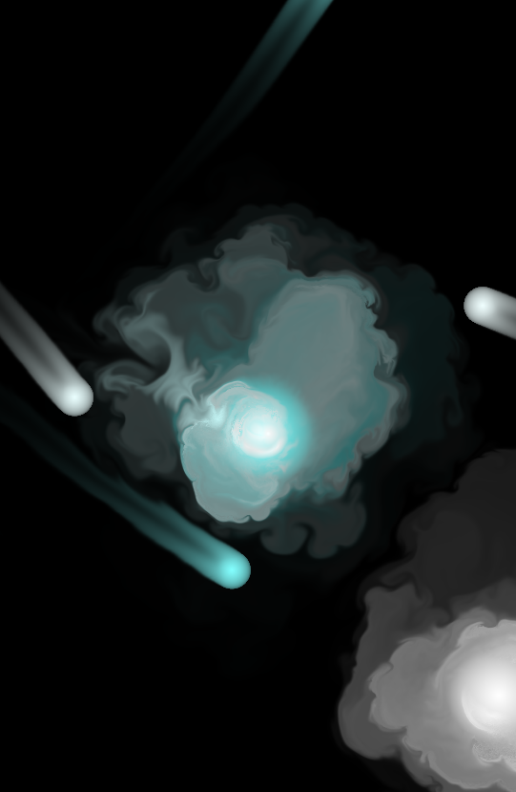
STEP
3
When the small ball run into the ghost, it disappears.
When all the balls disappears, the game ends.

Slide 7
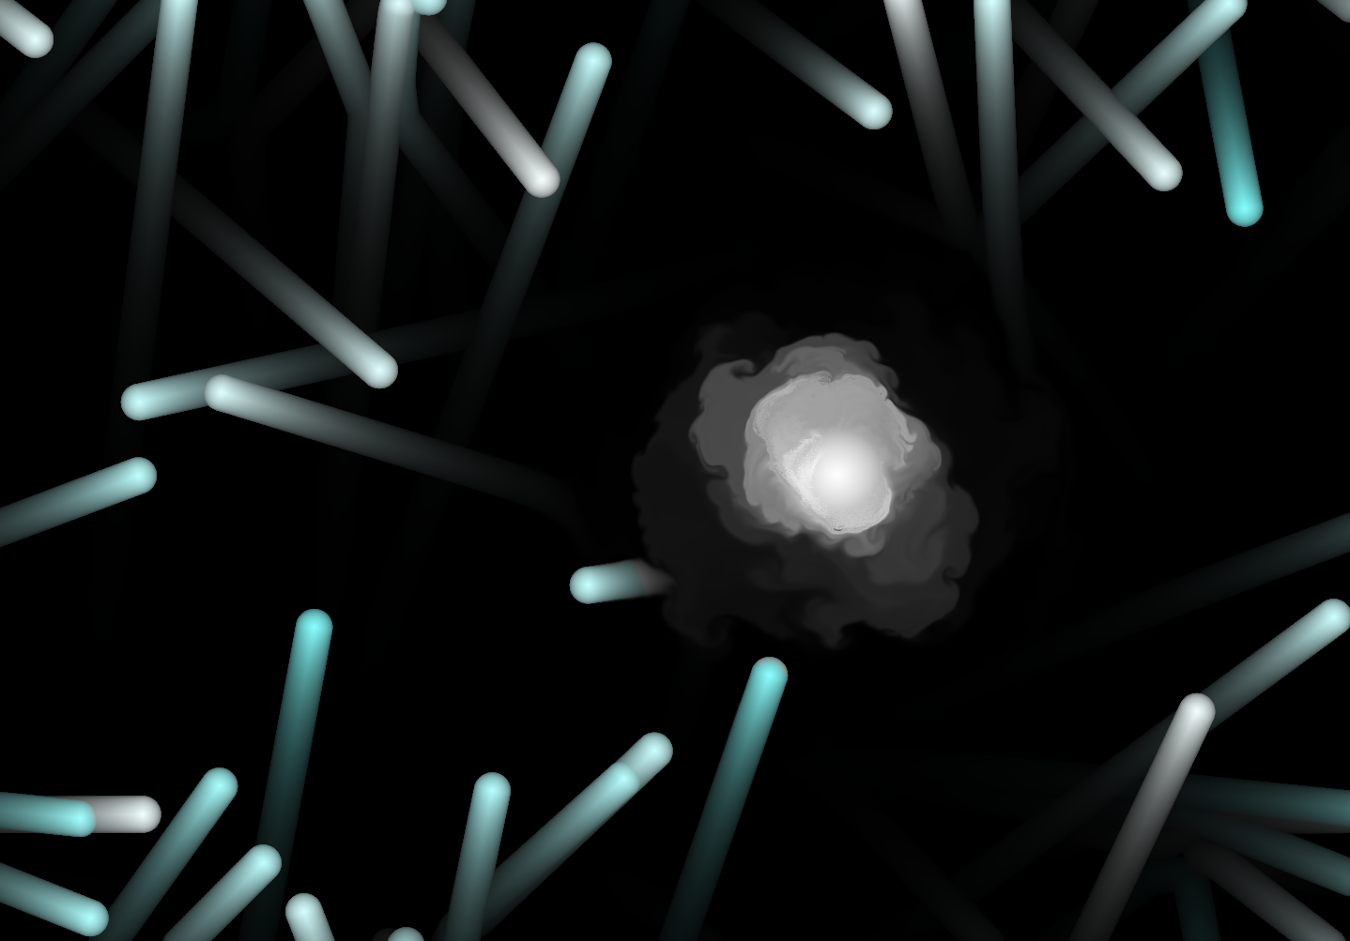
HIGHLIGHTS
OF
THE
GAME
02

Slide 8
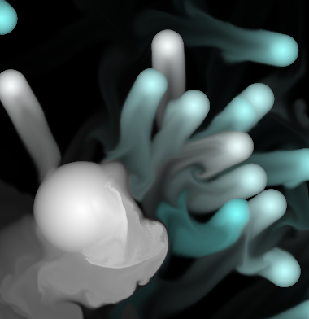
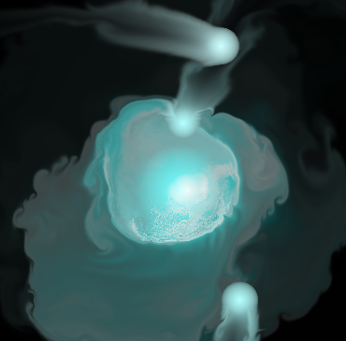
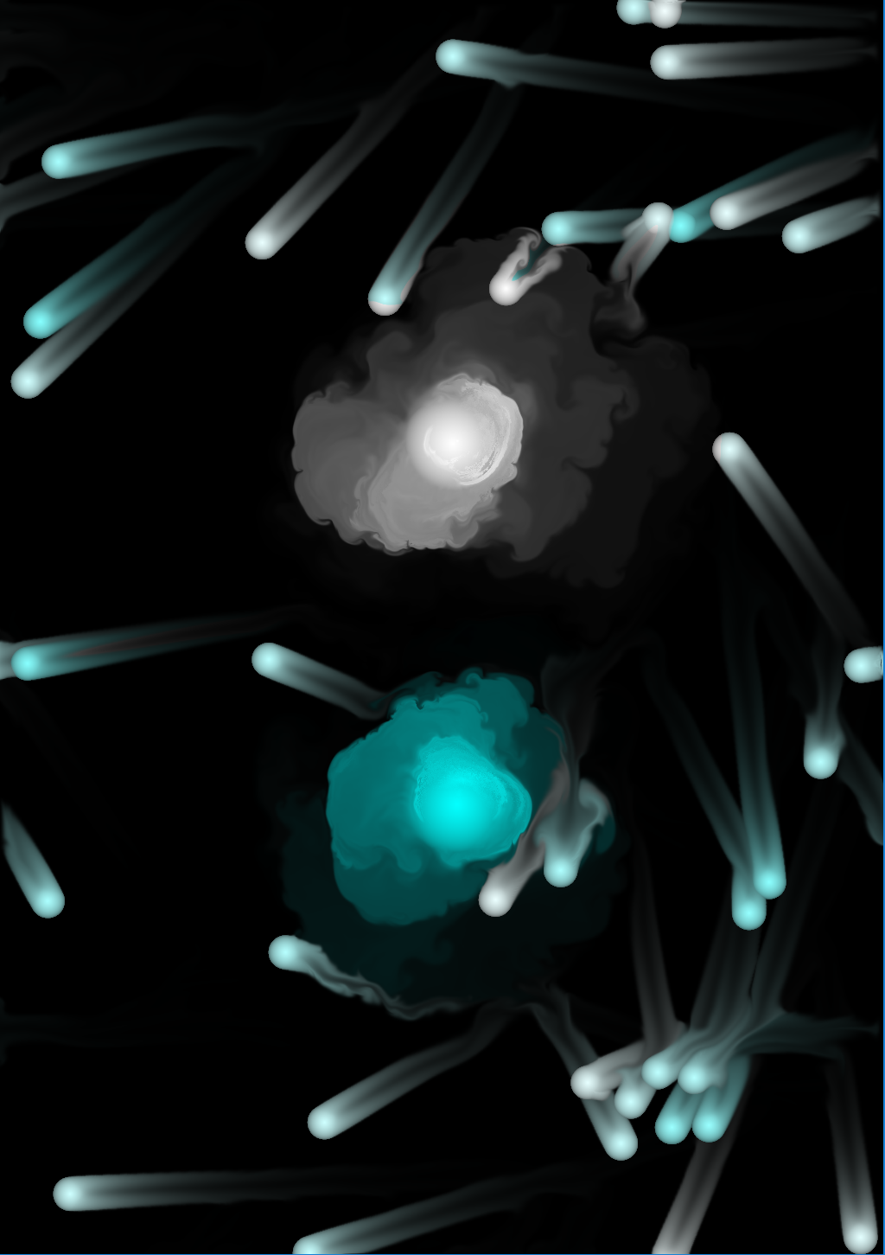
FLUID FLUID FLUID
The fluid form is the most fantastic part of this work.
When playing this game, you can feel as if you were using ink.
Special effects of chasing
The tail of the ball can blend like ink
Central ball will change its color if it eats small ball

Slide 9
EFFECTS
OF
THE
GAME
03

Slide 10




ONE
Help to relieve the pressure.
Two
Help to move the hang joints.

Slide 11
THANK YOU FOR
WACTHING
CREATED BY ZHANG ZHENYANG. SJTU SHANGHAI.

